Slide 1
Azure Study Group AZ-300 - Microsoft Azure Architect Technologies
Shawn Weisfeld
Cloud Solution Architect

Slide 2
Week 2 Implement workloads and security (25-30%)

Slide 3
Agenda
Agenda
1
Speaker Introduction
2
Feedback Loop
3
Objective Review
4
Open Mic
5

Slide 4
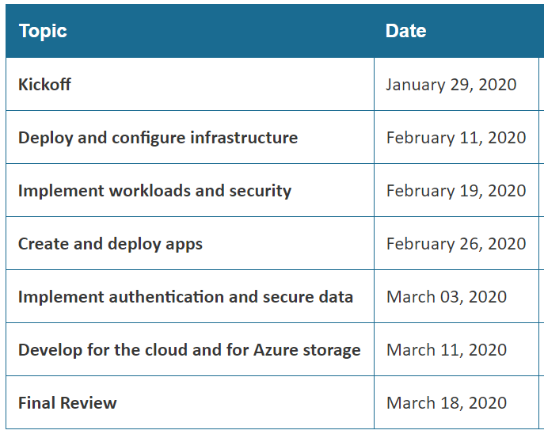
Series Agenda
Yammer: https://aka.ms/azurecsg
Homework:
https://aka.ms/AZ-300StudyGroup

Slide 5

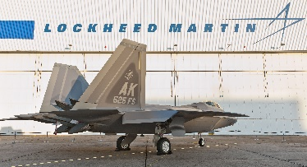




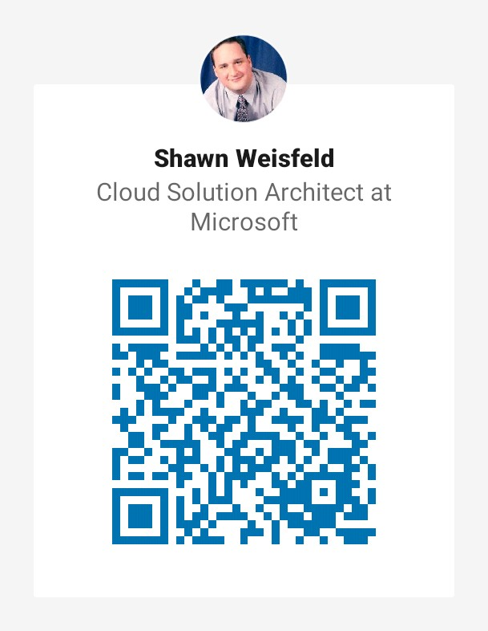













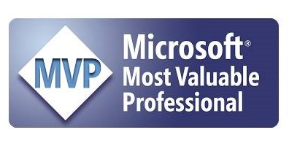




Slide 6
Feedback Loop

Slide 7
Migrate servers to Azure
migrate servers using Azure Migrate

Slide 8
About Azure Migrate
Unified migration platform: A single portal to start, run, and track your migration journey to Azure.
Range of tools: A range of tools for assessment and migration. The hub includes Azure Migrate: Server Assessment and Azure Migrate: Server Migration. It integrates with other Azure services, and with other tools and independent software vendor (ISV) offerings.
Assessment and migration: In the Azure Migrate hub you can assess and migrate:
Servers: Assess and migrate on-premises servers to Azure VMs.
Databases: Assess and migrate on-premises databases to Azure SQL DB, or to Azure SQL Managed Instance.
Web applications: Assess and migrate on-premises web applications to Azure App Service, using the Azure App Service Assistant.
Virtual desktops: Assess and migrate your on-premises virtual desktop infrastructure (VDI) to Windows Virtual Desktop in Azure.
Data: Migrate large amounts of data to Azure quickly and cost-effectively, using Azure Data Box products.

Slide 9
Azure Migrate tools
Azure Migrate: Server Assessment | Assess servers
Azure Migrate: Server Migration | Migrate servers
Database Migration Assistant (DMA) | Assess on-premises SQL Server databases for migration to Azure SQL DB, Azure SQL Managed Instance, or Azure VMs running SQL Server.
Database Migration Service (DMS) | Migrate on-premises databases to Azure VMs running SQL, Azure SQL DB, and Azure SQL Managed Instances.
Movere | Assess servers
Web App Migration Assistant | Assess and migrate on-premises web apps to Azure.
Azure Data Box | Offline data migration.

Slide 10
Configure serverless computing
create and manage objects
manage a Logic App resource
manage Azure Function app settings
manage Event Grid
manage Service Bus

Slide 11
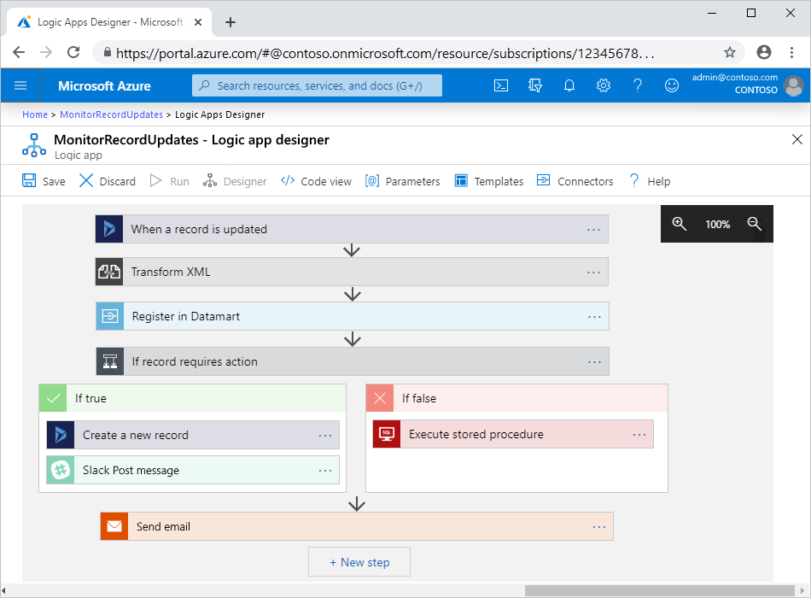
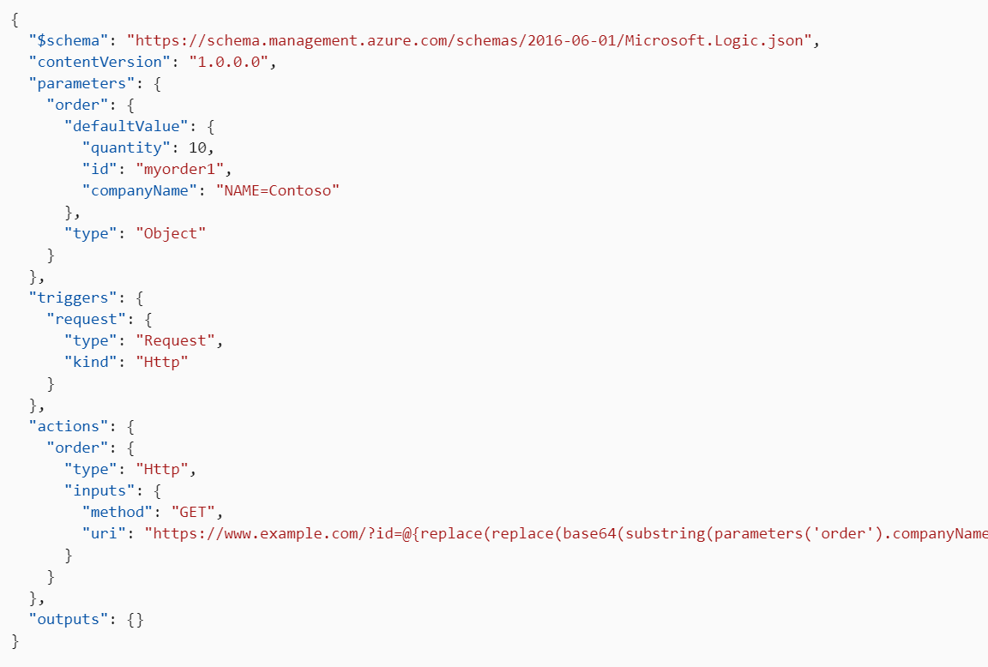
Azure Logic Apps
Serverless
Connectors
Visual

Slide 12
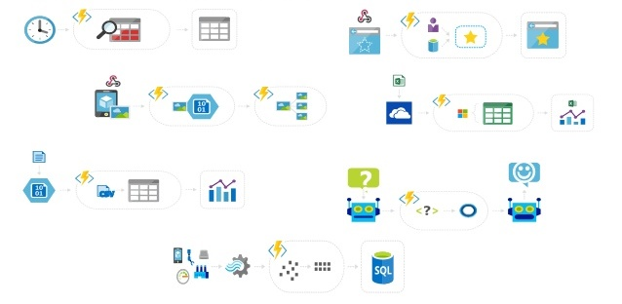
Azure Functions
Serverless (or by the core)
Triggers
Code focused (C#, Java, JS, POSH, Python & more)

Slide 13
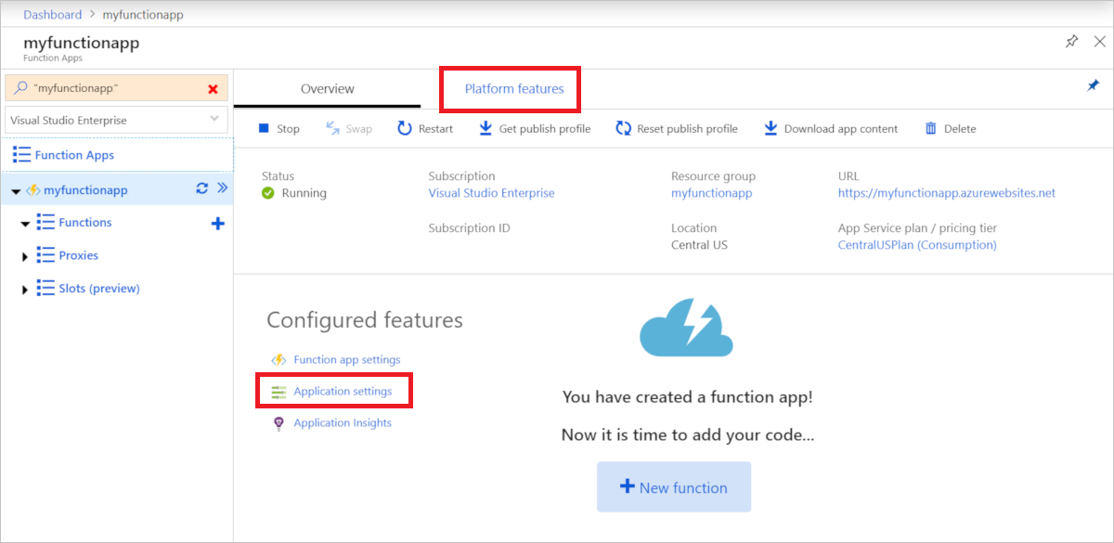
Azure Functions - Settings

Slide 14
Messaging in Azure
Event Grid – reactive programming
Event Hub (IoT Hub) – big data pipeline
Kafka (HD Insight/Event Hub)
Service Bus – high value enterprise messaging
Storage Queues

Slide 15
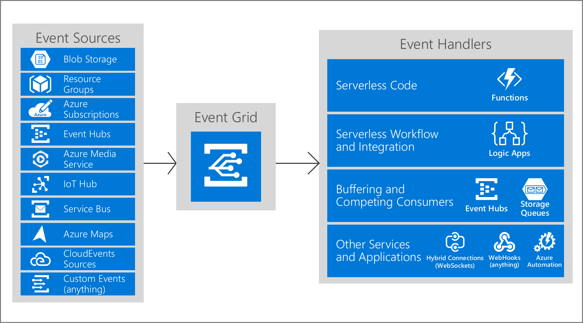
Azure Event Grid

Slide 16
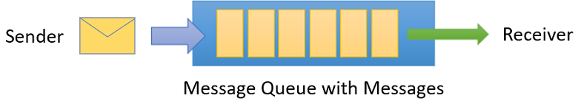
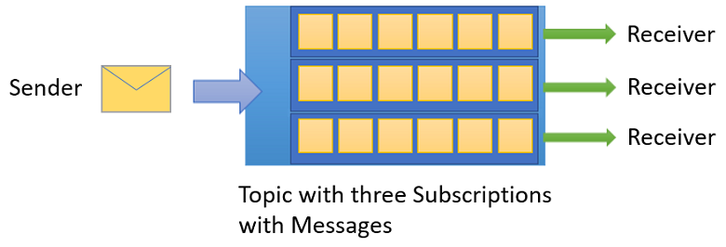
Azure Service Bus

Slide 17
Implement application load balancing
configure application gateway
configure Azure Front Door service
configure Azure Traffic Manager

Slide 18
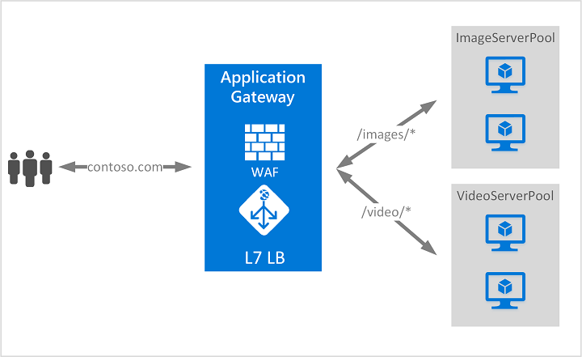
Application Gateway
Secure Sockets Layer (SSL/TLS) termination
Web application firewall
URL-based routing
Session affinity
Rewrite HTTP headers
In an Azure region

Slide 19
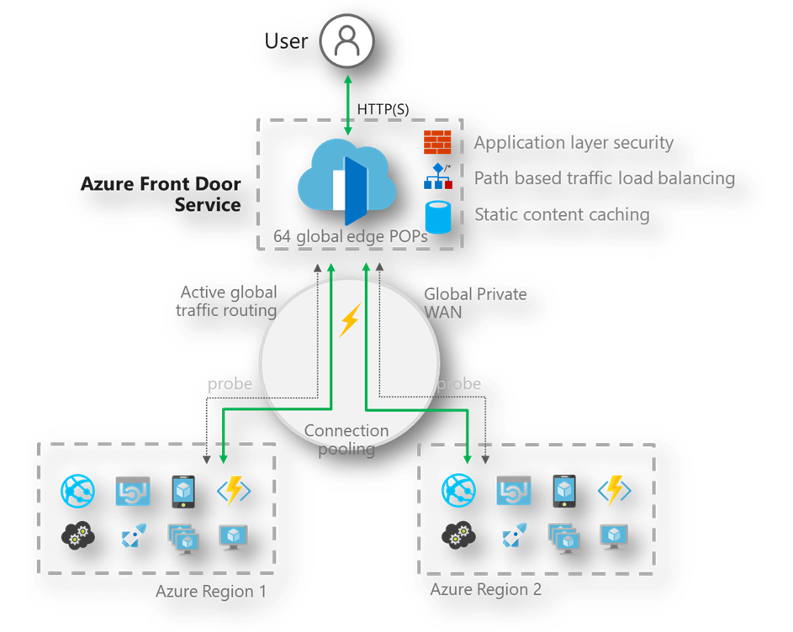
Azure Front Door
Accelerate application performance
smart health probes
URL-based routing
Multiple-site hosting
Session affinity
Secure Sockets Layer (SSL) termination
Application layer security (WAF)
Between Azure Regions

Slide 20
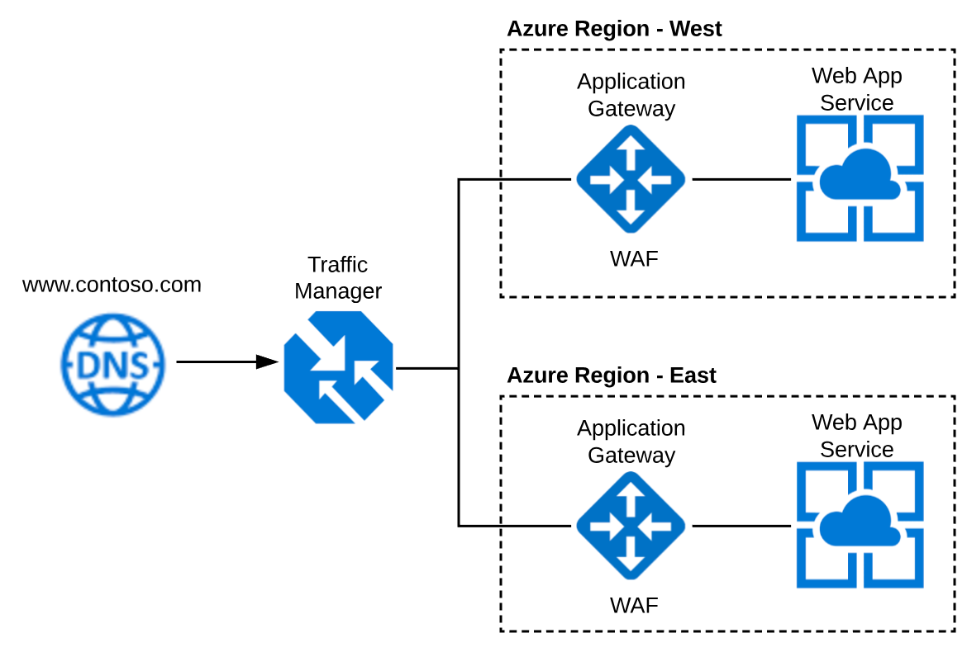
Azure Traffic Manager
DNS-based traffic load balancer
Between Azure Regions

Slide 21
Integrate on premises network with Azure virtual network
create and configure Azure VPN Gateway
create and configure site to site VPN
configure ExpressRoute
configure Virtual WAN
verify on premises connectivity
troubleshoot on premises connectivity with Azure

Slide 22
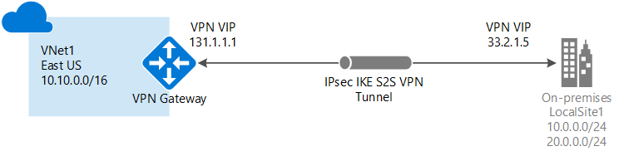
Azure VPN Gateway & Site to Site VPN

Slide 23
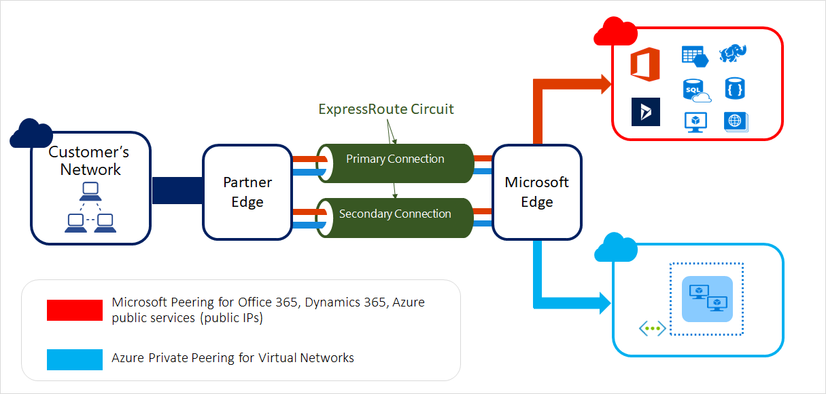
ExpressRoute

Slide 24
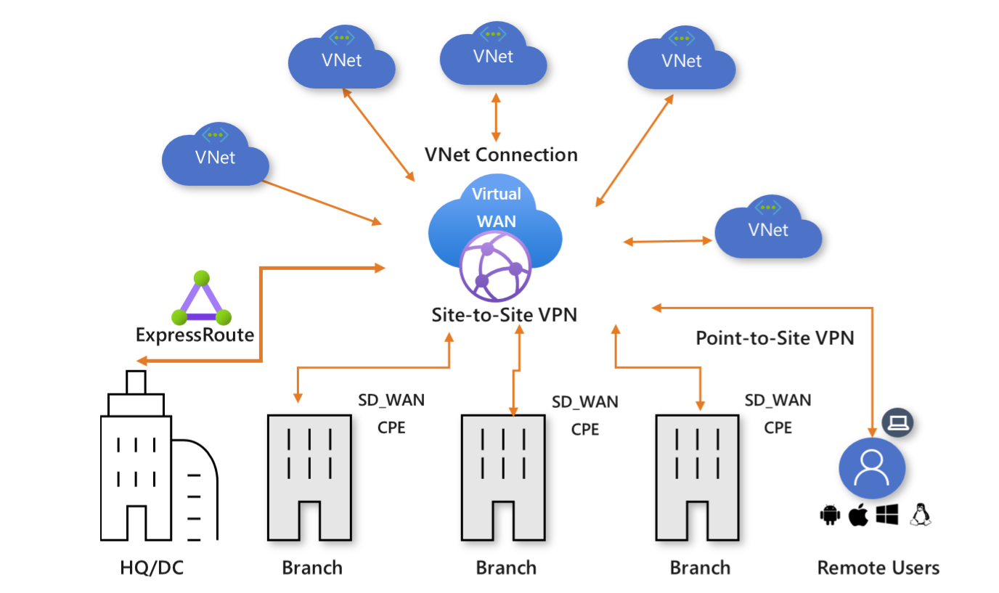
Azure Virtual WAN

Slide 25
Implement multi factor authentication
configure user accounts for MFA
configure fraud alerts
configure bypass options
configure trusted IPs
configure verification methods

Slide 26
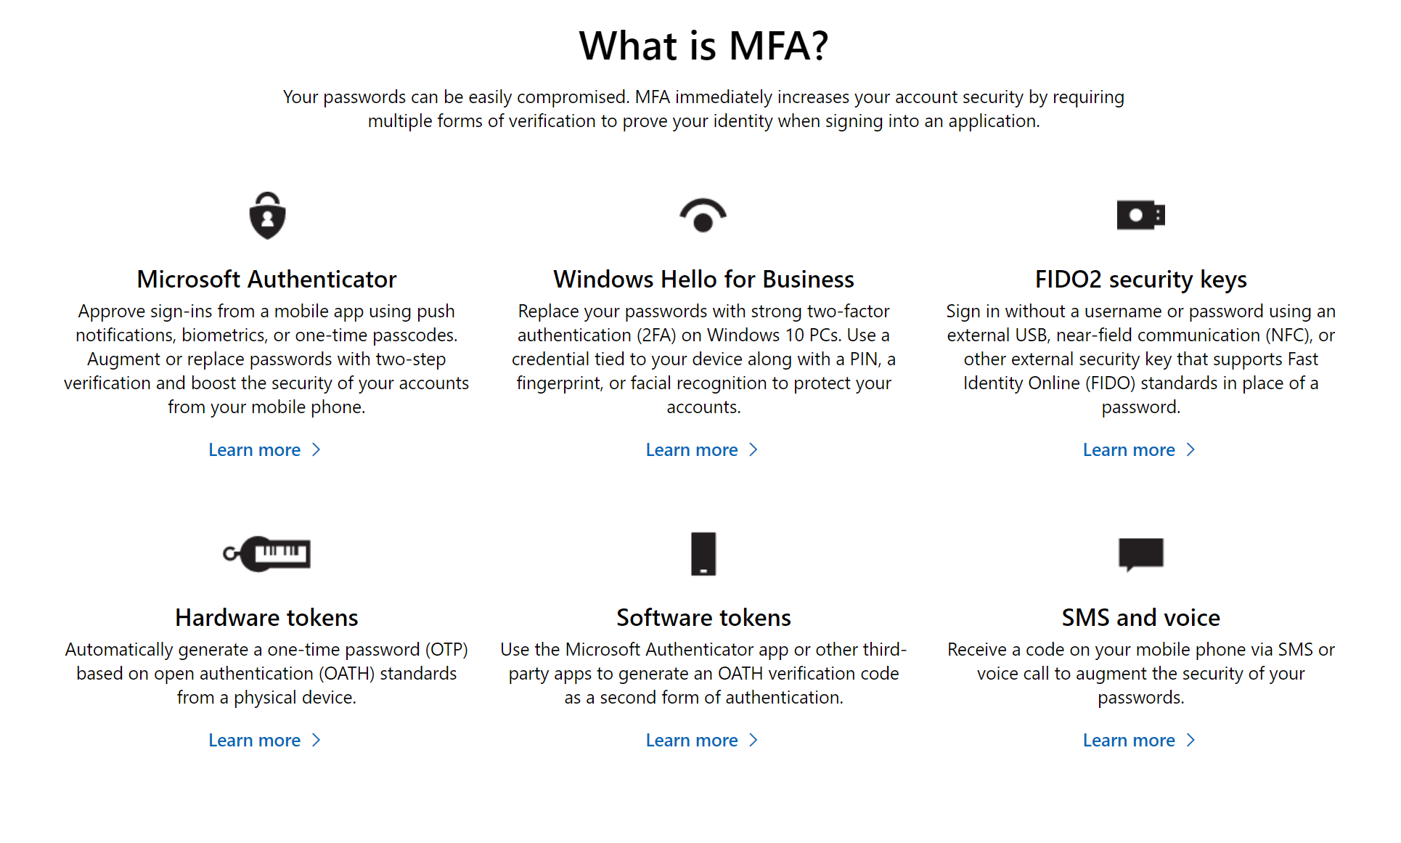
Multi Factor Authentication

Slide 27
Manage role-based access control
create a custom role
configure access to Azure resources by assigning roles
configure management access to Azure
troubleshoot RBAC
implement Azure Policies
assign RBAC Roles

Slide 28
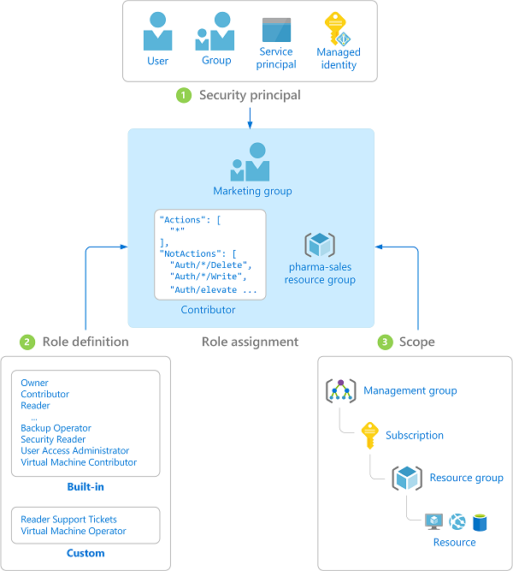
Role-based access control (RBAC)
Security Principal – wants access
Role Definition – collection of permissions
Scope – set of resources
Role Assignment – attachment of the other 3

Slide 29
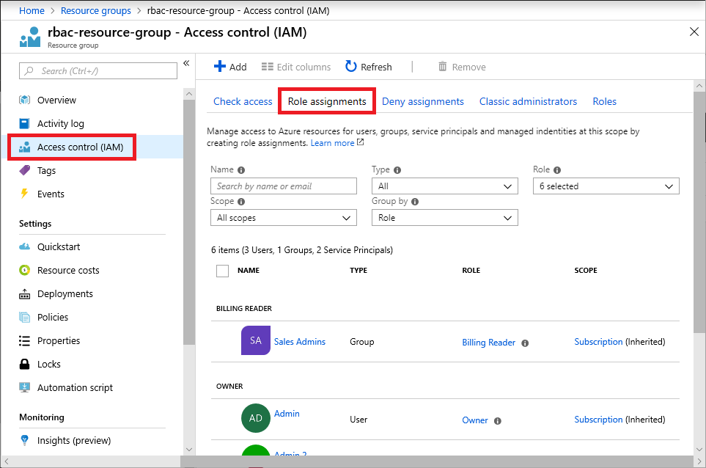
Assigning RBAC Roles

Slide 30
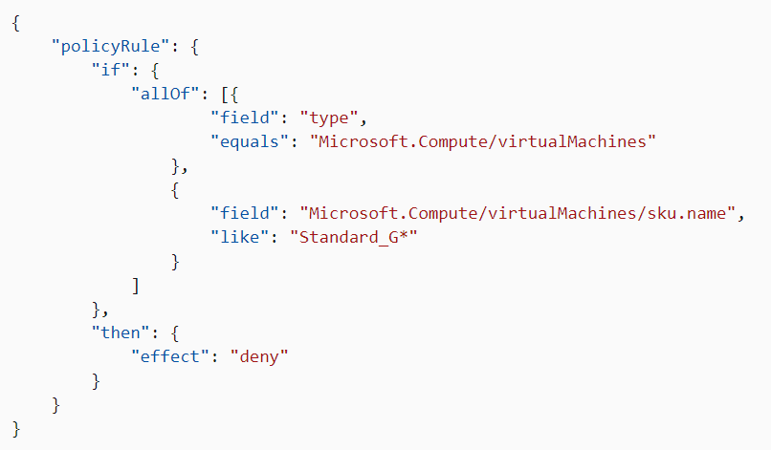
Azure Policy
policies enforce different rules and effects over your resources

Slide 31


Questions?

Slide 32
Homework Assignment
https://aka.ms/AZ-300StudyGroup

Slide 33

Open Mic …

